Slide 1

9 Answers Your CISO Prospect Needs
A Content Strategy Template
Andy Ellis
Operating Partner

Slide 2


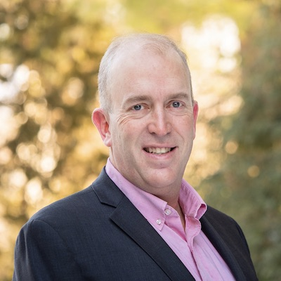
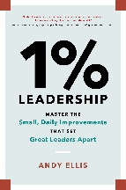

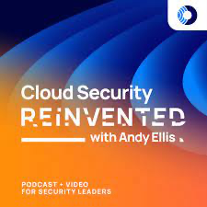





Who am I?
2021 inductee
CSO Hall of Fame
Former CSO
Akamai
Author
1% Leadership
Former Officer
US Air Force
Advisory CISO
Orca Security
Podcast of the Year
SANS DMA
Andy Ellis
Operating Partner
YL Ventures
Spirit of Disneyland
Disneyland
www.csoandy.com
@csoandy
CEO/Principal
Duha
Award of Excellence
Wine Spectator

Slide 3
A perfect sales conversation?
Wow, I was just looking for this!
Here is my tool. Want to buy it?
Score! Quota retired!
Can you send me a proposal?

Slide 4
The CISO
Wow, I was just looking for this!

Slide 5



TEMPLATE
What do you need them to believe?
What is the question?
What soundbites might change their mind?
Where will they believe those messages?
Who can credibly deliver that message?
What does the target believe?
“Target” may be buyer/CISO/peer

Slide 6



Location
Security problems don’t just exist in a vacuum. There’s an environment that has a risk that you solve.
Where is the problem?
Who owns this environment?
Who operates this environment?
How critical is this environment?
How aware of this environment is the CISO?

Slide 7
Problem
There is a scenario: some set of hazards that, if triggered, lead to an unacceptable loss.
What is the problem?
What teams are affected by the loss?
How bad is the unacceptable loss?
What risks are worse?
What breaches is this like?
How well articulated is the risky scenario?
Location

Slide 8
Urgency
Businesses need to address lots of risks. Where does this one rank?
How urgent is fixing the problem?
Is this just like a problem in the news?
How surprising would this be?
What risks are worse?
How disruptive is this problem?
Location
Problem

Slide 9



Ownership
Not all problems are owned by the CISO. Do they think they own this problem?
Who owns the problem?
Do they govern fixing this problem?
Are they operationally responsible?
Who else might own the problem?
On the list of problems I need to fix, where does this rank?
Location
Problem
Urgency

Slide 10
Peer-ception
Sometimes CISOs don’t own all security problems.
Who think the CISO owns the problem?
Would a peer be embarrassed?
Who needs to buy in to a solution?
Is there political capital to tackle this problem?
Whose toes would I step on if I tackled this problem?
Location
Problem
Urgency
Ownership

Slide 11
Buy-In
Sometimes other stakeholders really worry about a problem – but other times, they see the CISO as the problem.
Who else cares about the problem?
Is this viewed as compliance?
Is this problem seen as too esoteric?
Would fixing this be seen as disruptive to business plans?
How much education do I need to do about this problem?
Location
Problem
Urgency
Ownership
Peer-ception

Slide 12



Solution
What is the technical solution: people, process, and tools?
How can I solve this problem?
Is there evidence this works?
Is this rooted in buzzwords, or fact?
Does this solve one problem, or many?
How well do I expect this to address the problem?
Location
Problem
Urgency
Ownership
Peer-ception
Buy-In

Slide 13
Viability
Some solutions look great on paper but are too expensive to implement.
Is this solution tractable?
How long is integration?
How quickly do we see results?
How much support does it take?
Where are process bottlenecks?
Will our organization accept this solution?
Location
Problem
Urgency
Ownership
Peer-ception
Buy-In
Solution

Slide 14
Budget
Some solutions line up to existing budgets. Other times, CISOs have to go looking for money.
Can I afford this solution?
Will this replace existing tools?
Is this already in the budget?
Are executives expecting a new request?
Can I defer this?
How am I going to sell this to the rest of the business?
Location
Problem
Urgency
Ownership
Peer-ception
Buy-In
Solution
Viability

Slide 15
Location
Problem
Urgency
Ownership
Peer-ception
Buy-In
Solution
Viability
Budget

Slide 16
Location
Problem
Urgency
Where is the problem?
What is the problem?
How urgent is fixing the problem?
Ownership
Peer-ception
Buy-In
Who owns the problem?
Who think the CISO owns the problem?
Who else cares about the problem?
Solution
Viability
Budget
How can I solve this problem?
Is this solution tractable?
Can I afford this solution?

Slide 17
Location
Problem
Urgency
Ownership
Peer-ception
Buy-In
Solution
Viability
Budget

Slide 18
Location
GTM Funnel
Problem
Urgency
Ownership
Peer-ception
Buy-In
Solution
Viability
Budget

Slide 19
Thought Leadership
Location
Content Strategy
Problem
Urgency
Ownership
Peer-ception
Buy-In
Solution
Viability
Budget
Product Marketing

Slide 20
Location
Content Strategy
Problem
Urgency
Thought Leadership
Ownership
Peer-ception
Buy-In
Solution
Product Marketing
Viability
Budget

Slide 21
Location
Content Strategy
Problem
Thought Leadership
Urgency
Ownership
Peer-ception
Product Marketing
Buy-In
Solution
Viability
Budget

Slide 22
Content Strategy
Thought Leadership
Ownership
Peer-ception
Product Marketing
Buy-In
Solution
Urgency
Problem
Viability
Location
Budget

Slide 23
Content Strategy
Thought Leadership
Ownership
Buy-In
Product Marketing
Peer-ception
Solution
Urgency
Problem
Viability
Location
Budget

Slide 24
Content Strategy
Thought Leadership
Viability
Solution
Budget
Ownership
Buy-In
Product Marketing
Peer-ception
Urgency
Problem
Location

Slide 25



Thank you

Slide 26
Location
Problem
Urgency
Where is the problem?
What is the problem?
How urgent is fixing the problem?
Ownership
Peer-ception
Buy-In
Who owns the problem?
Who think the CISO owns the problem?
Who else cares about the problem?
Solution
Viability
Budget
How can I solve this problem?
Is this solution tractable?
Can I afford this solution?

Slide 27
TEMPLATE
What do you need them to believe?
What is the question?
What soundbites might change their mind?
Where will they believe those messages?
Who can credibly deliver that message?
What does the target believe?
“Target” may be buyer/CISO/peer

